Slide 1

Basic Details of the Team and Problem Statement
Ministry/Organization Name/Student Innovation:
Ministry of Ayurveda, Yoga, Naturopathy, Unani, Siddha,
Sowa-Rigpa and Homoeopathy (AYUSH).
PS Code: DK731 Problem Statement Title: Mobile Application For Diet Recall Team Name: ELITE SAPIENS Team Leader Name: VARSHINI M Institute Code: C-37057 (AISHE CODE)
Institute Name: Sri Eshwar College Of Engineering
Theme Name: MedTech / BioTech / HealthTech

Slide 2
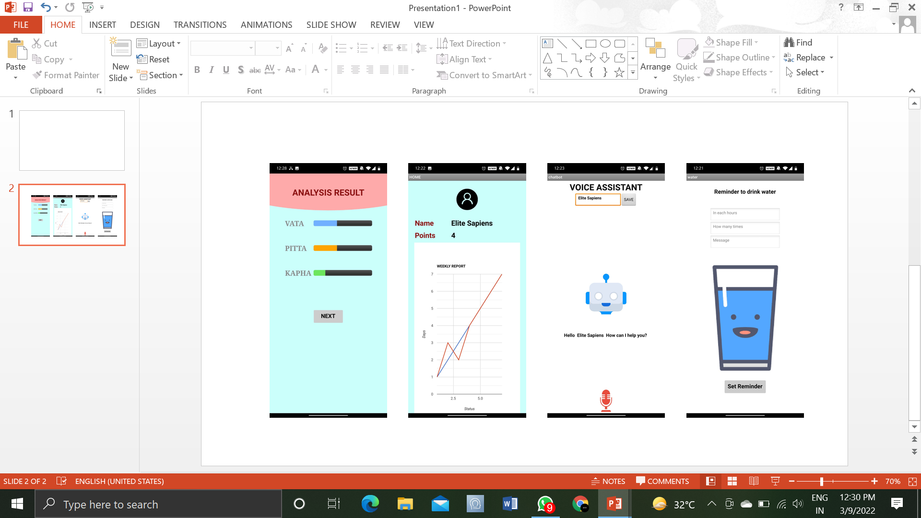
Idea/Approach Details
PPROTOTYPE
IDEA
Providing ayurvedic diet app to stabilize ayurvedic doshas.
To Clarify user’s queries.
Generating report of the user.
To motivate users to follow the diet regularly.
SOLUTION
Providing diet plan according to their doshas and rasa.
Users are asked to recall all foods consumed in 24/7 days.
Introducing AI Chatbot to clarify their queries.
Graphical representation of weekly & monthly report.
Notifying user to drink water and take their food.
Providing gamification features to follow the diet regularly.
Technology stack:
AI Based technology
Android studio

Slide 3
Idea/Approach Details
Use Cases
User can clarify their queries using voice assistant.
User with infirmity can contact experts through Chatbot.
In unavoidable situations, user can report us so that we will plan their diet accordingly.
In festival times, most of the users follow fasting in such case, they can report us through chat box.
Users who doesn’t follow the diet plan regularly will be alerted through friendly warning messages and motivational quotes.
Dependencies
Dosha identification through quiz analysis.
Ayurvedic dietician.
Customized diet plan based on rasa.
Users progress report.

Slide 4
Team Member Details
Team Leader Name: VARSHINI M
Branch : B.E Stream : CSE Year : I
Team Member 1 Name: SHANMUGAPRIYAN N
Branch : B.E Stream : Mech Year : I
Team Member 2 Name: VENKATESHRAMKUMAR G
Branch : B.E Stream : CSE Year : I
Team Member 3 Name: UDHAYA LAKSHMI P
Branch : B.E Stream : CSE Year : I
Team Member 4 Name: SREE RAGU NANDHA T
Branch : B.E Stream : CSE Year : I
Team Member 5 Name: BADRII TS
Branch : B.E Stream : ECE Year : I
Team Mentor 1 Name: Ms. S. SARADHA
Category : Academic Expertise : AI, ML, Datascience management Domain Experience : 4 years in domain and 8.4 years in total
Team Mentor 2 Name: Mr.N.VISHNU SAKRAVARTHY
Category : Academic and Industry Expertise : ML and IOT Domain Experience : 2 years in Industry and 2.7 years in Academic.

